Slide 1
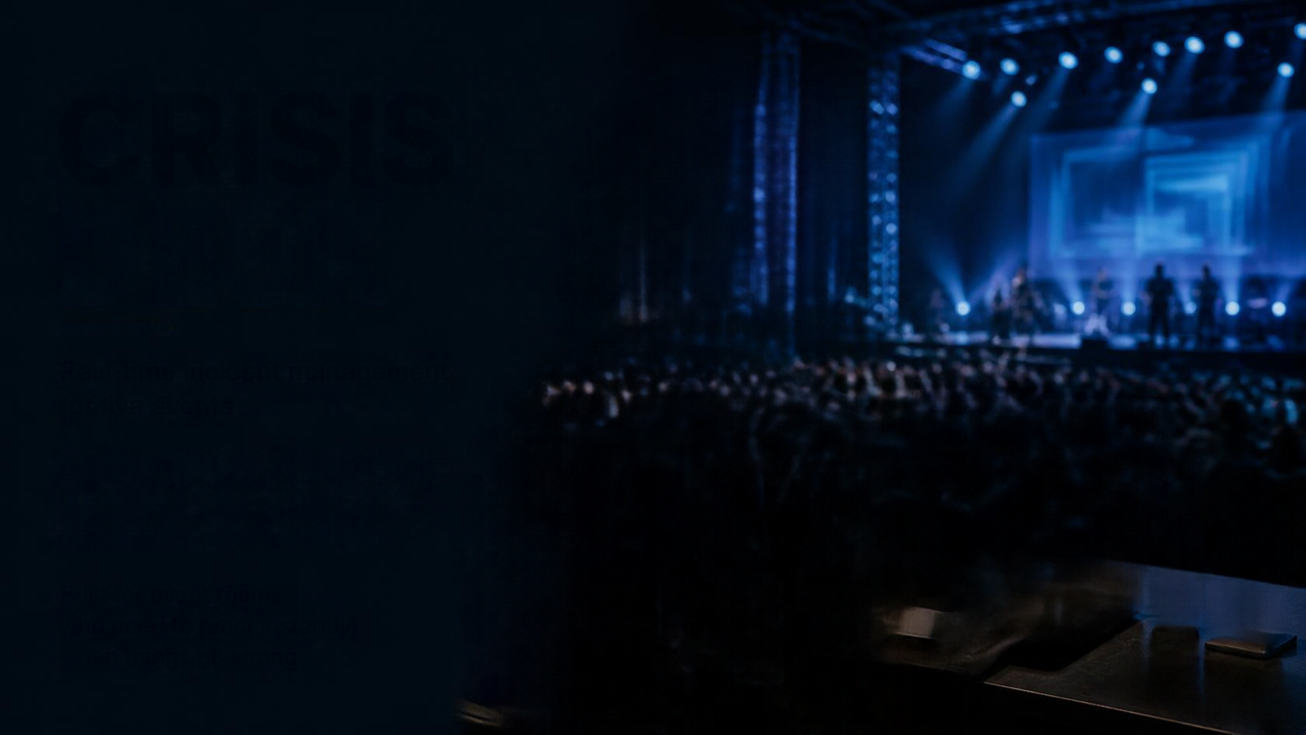
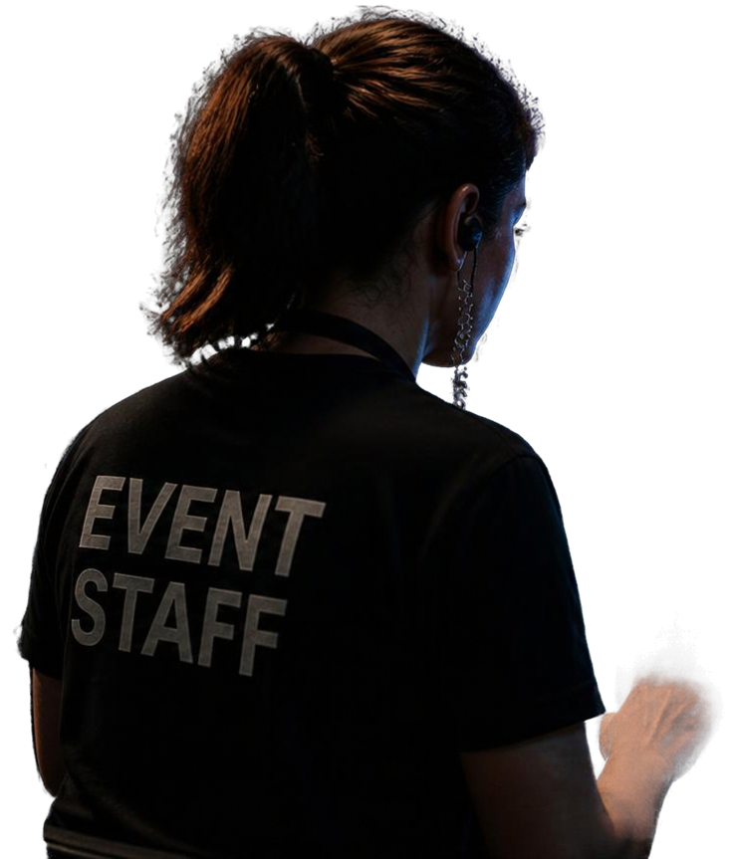
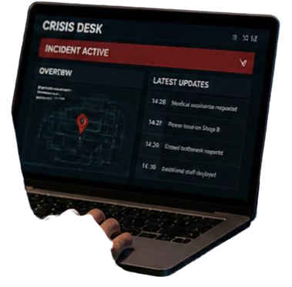
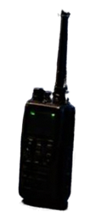
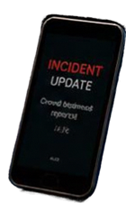

CRISIS
DESK
Real-time incident management for live events
ADAPT FAST. STAY CALM. NEVER LOSE CONTROL OF AN EVENT AGAIN.
Built for event teams
who need to react instantly when things go wrong

Slide 2
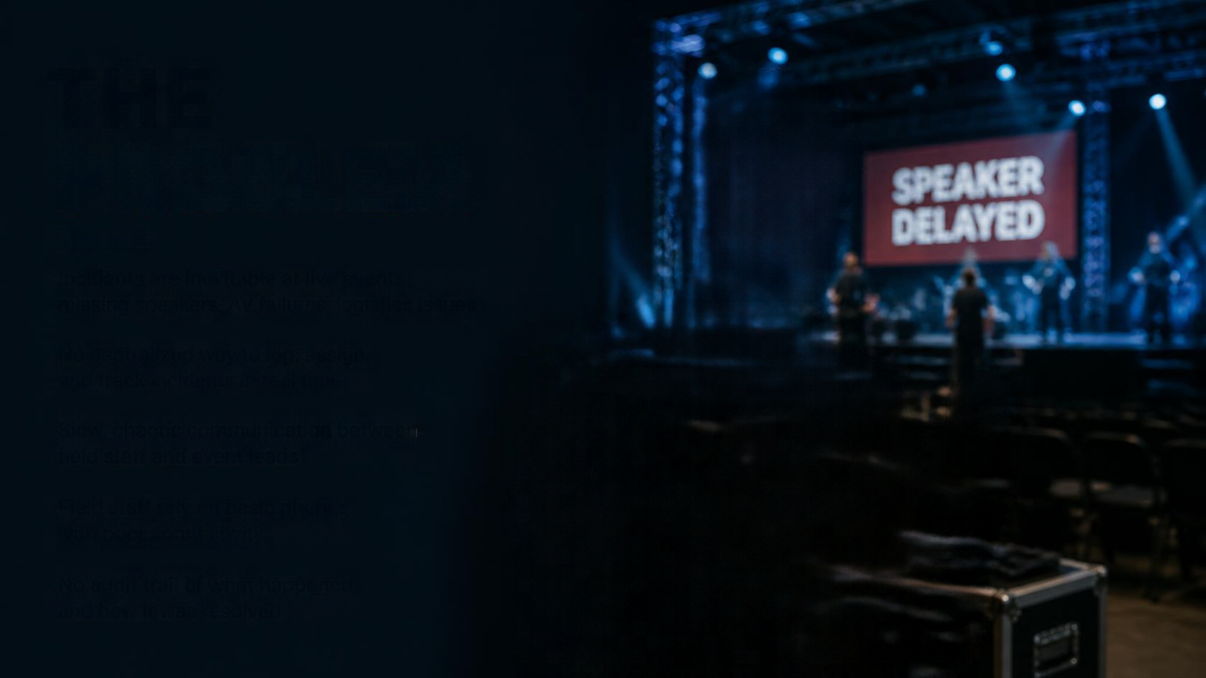
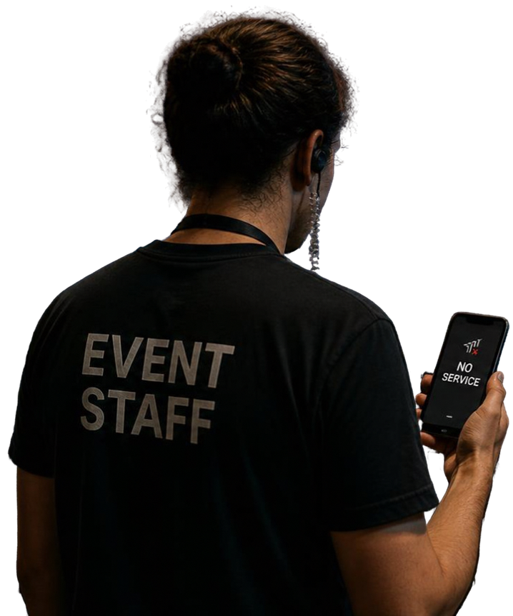

THE
PROBLEM
Incidents are inevitable at live events missing speakers, AV failures, logistics issues
No centralized way to log, assign, and track incidents in real time
Slow, chaotic communication between field staff and event leads
Field staff rely on basic phones with poor connectivity
No audit trail of what happened and how it was resolved

Slide 3

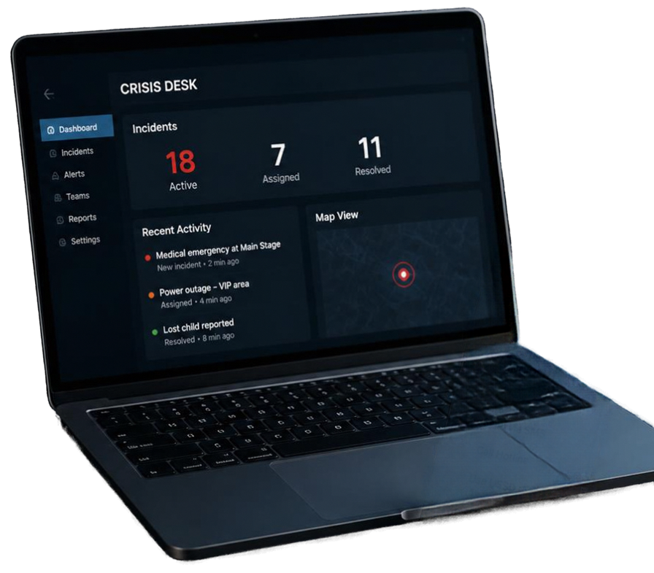

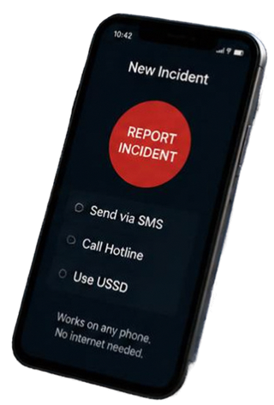
THE
SOLUTION
Crisis Desk gives event teams a real-time Crisis Desk to log, route and resolve incidents fast.
A dedicated real-time incident management platform for events
Android app for field staff, web Command Center for event leads
Multi-channel alerts via SMS
Complete timeline and audit trail of every incident

Slide 4

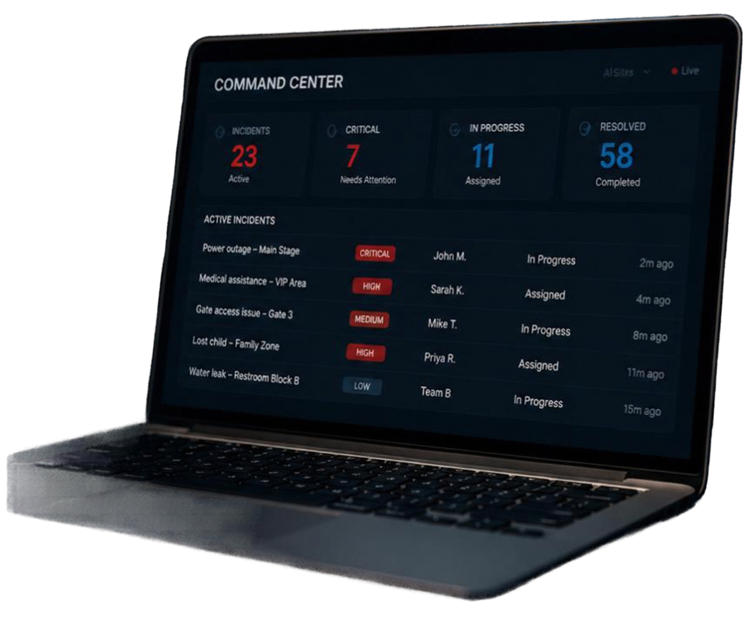






HOW IT
WORKS
1
2
3
4
5
Field staff log an incident in under 20 seconds via app, web, or USSD
Event Lead assigns and tracks status live on the Command Center dashboard
Team updates status and adds comments in real time
Resolution is recorded with notes, building a full audit trail
System auto-notifies the right people by SMS, push, or voice call escalation for critical issues
Firebase
Africa’s Talking
POWERED BY
(Firestore, Cloud Functions)
(SMS)

Slide 5

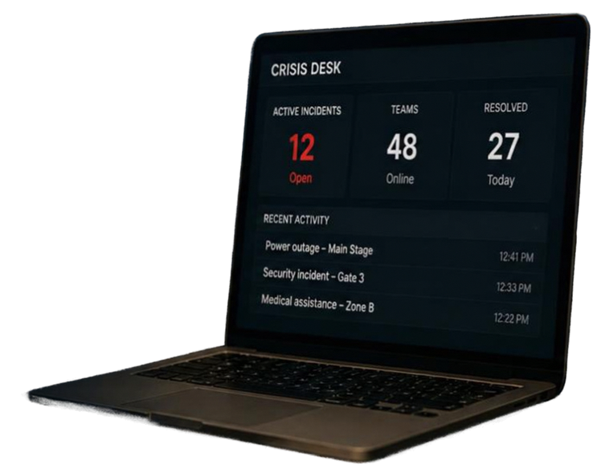








BUSINESS
MODEL
Simple, scalable pricing built for live events
PER-EVENT
SEASON / ENTERPRISE
ADD-ON REVENUE
Flat fee per live event based on team size and duration
Plans for agencies running multiple events per year
SMS/Voice usage via Africa’s Talking pass-through
WHO WE SERVE
FUTURE UPSIDE
Event management agencies
Conference organizers
AI-powered response recommendations
Festival operators
Analytics dashboards

Slide 6

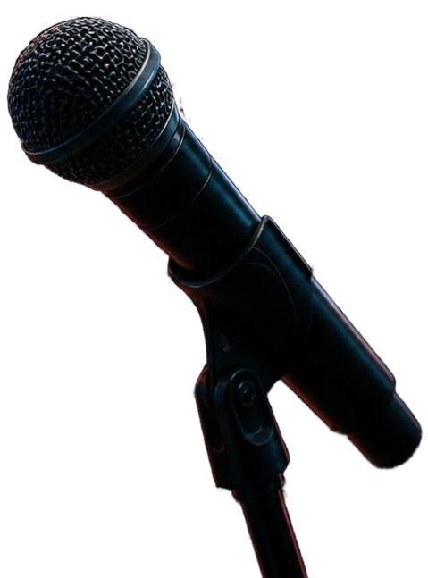
THANK YOU
Crisis Desk helps you expect the unexpected. Respond with confidence.
Let’s talk about bringing Crisis Desk to your next event.

